Slide 1
DIPARTIMENTO DI INGEGNERIA INDUSTRIALE
Master Science Degree on Autonomous Vehicle Engineering I year I Semester
CONTROL SYSTEMS FOR AUTONOMOUS GROUND VEHICLES
Challenge 2022/2023
Team:
1. Sudip Kishan Sarker (P44000039)
2. Niloy Saha (P44000040)
Prof. Stefania Santini

Slide 2
Problem Statement: Design of Autonomous Vehicles Control under Variable Speed Limit (VLS) system:-
The challenge aim is to design an ADAS system for a CAV such that the following requirements are satisfied:
The CAV tracks the reference behaviour imposed by RSU;
The CAV speed does not exceed the speed limits imposed by the RSU;
The CAV maintain a desired distance w.r.t. the preceding vehicle.

Slide 3
GENERAL LAYOUT OF SYSTEM:-
R
PLANT
LAYOUT
PLANT OUTPUT
C
P
EGO VEHICLE
Where, P= Plant
LEADER VEHICLE
C= Controller
PID
MPC
R= References
ADAPTIVE CRUISE CONTROL (ACC)

Slide 4
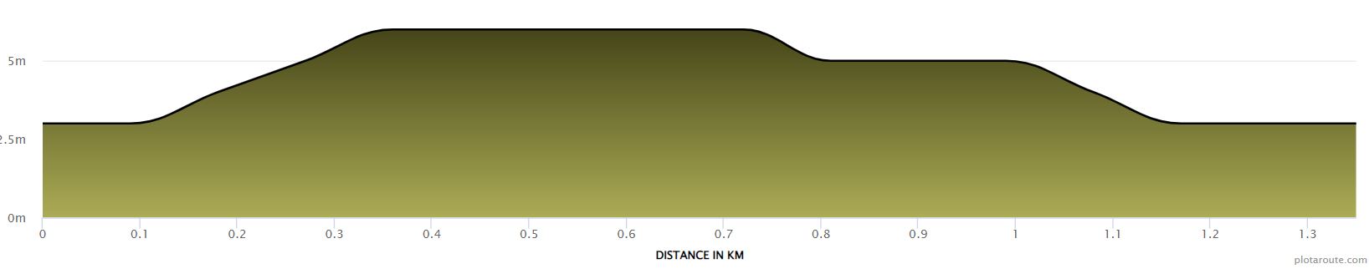

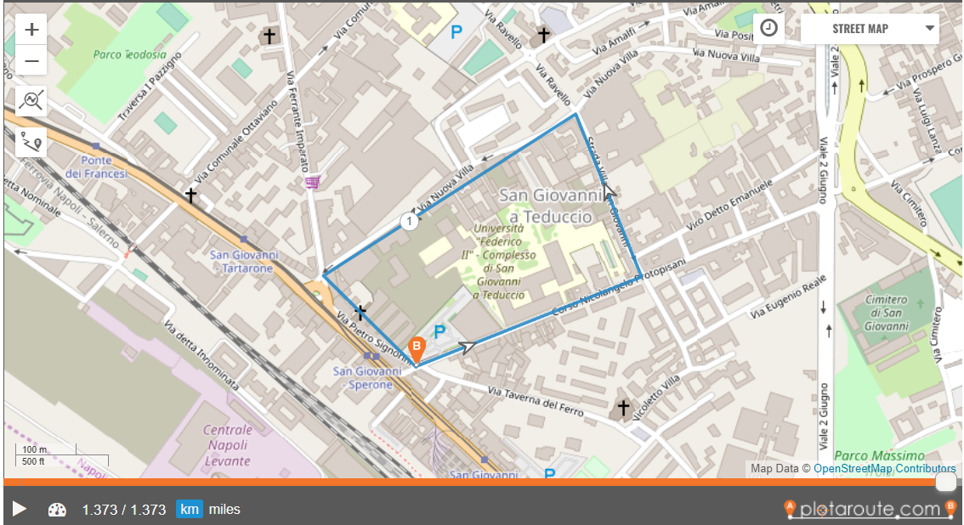
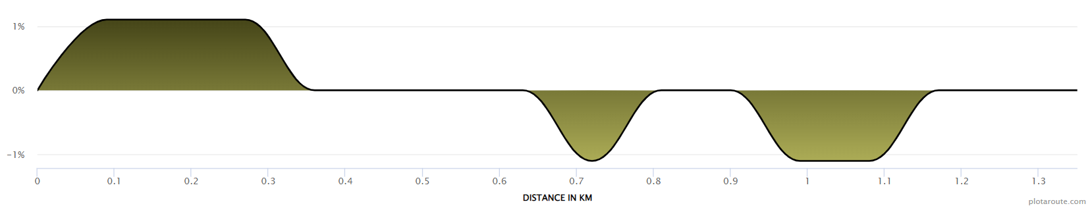

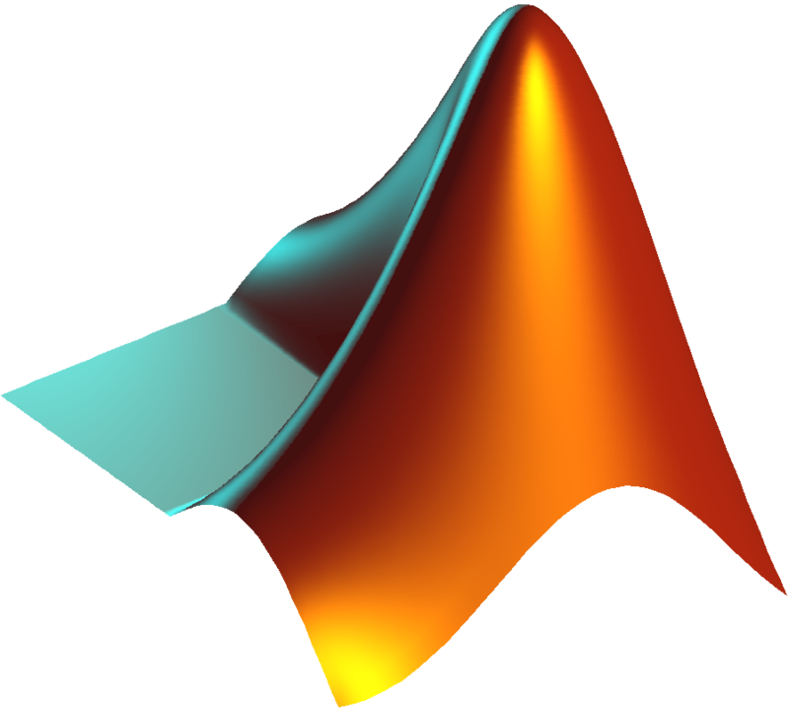
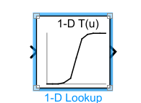
FOR THE ROUTE:-
https://www.plotaroute.com/route/2236019?units=km

Slide 5
BASIC INFORMATION ABOUT EGO VEHICLE, LEADING VEHICLE AND CONTROLLER:-
EGO VEHICLE: An ego vehicle is an autonomous vehicle equipped with sensors and control systems to navigate and operate in its environment.
LEADER VEHICLE: A leader vehicle is a vehicle that sets the behavior and trajectory for other vehicles to follow or emulate in a coordinated manner.
CONTROLLER: In the context of autonomous driving, a controller is a software or hardware component that utilizes algorithms and sensors to make decisions and control the movements of a vehicle. It manages the acceleration, braking, and steering actions of the vehicle to navigate and interact with the environment.

Slide 6
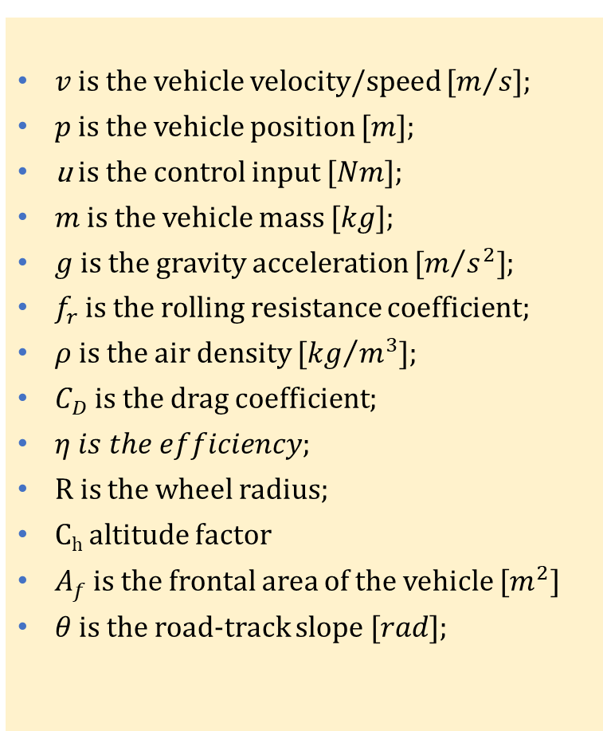
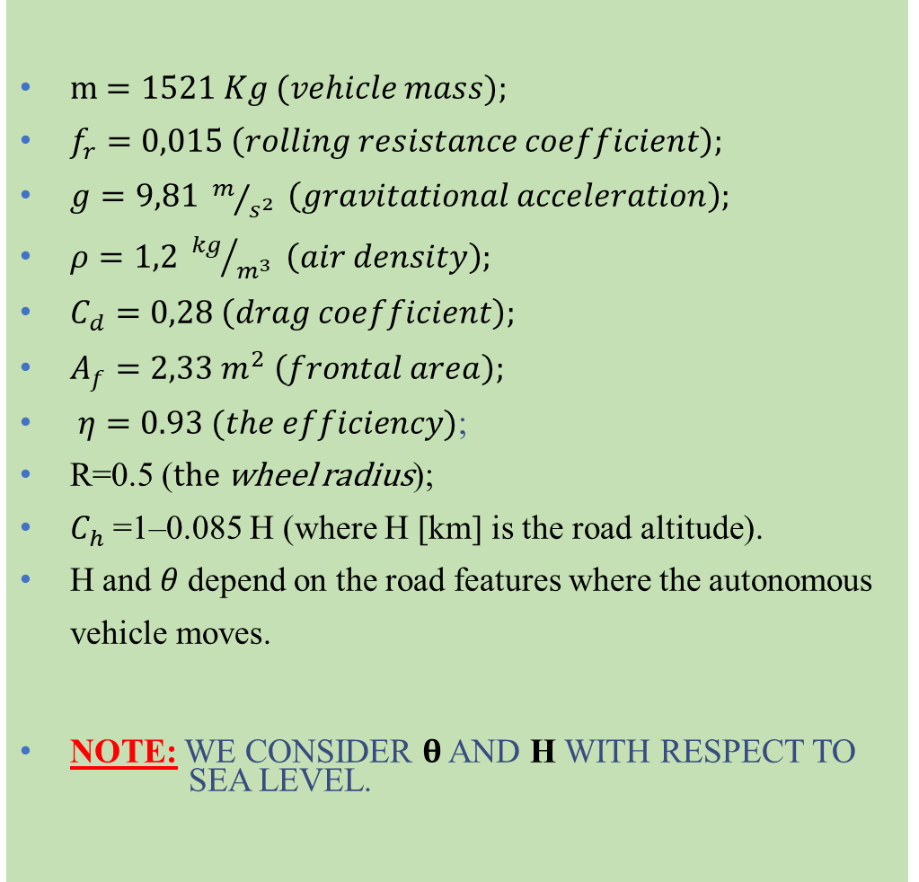
VEHICLE DYNAMICS PARAMETERS:
m $=1521 Kg (vehicle mass);$
$f_{r}=0,015 \left(rolling resistance coefficient\right);$
$g=9,81 m/{s^{2}} \left(gravitational acceleration\right);$
$ρ=1,2 {kg}/{m^{3}} \left(air density\right);$
$C_{d}=0,28 \left(drag coefficient\right);$
$A_{f}=2,33 m^{2} \left(frontal area\right);$
$η=0.93 (the efficiency)$;
R=0.5 (the wheel radius);
$C_{h}$=1–0.085 H (where H [km] is the road altitude).
H and $θ$depend on the road features where the autonomous vehicle moves.
NOTE: WE CONSIDER $θ$ AND H WITH RESPECT TO SEA LEVEL.
$v$ is the vehicle velocity/speed $[m/{s]}$;
$p$ is the vehicle position $[m]$;
u is the control input $[Nm]$;
$m$ is the vehicle mass $[kg]$;
$g$ is the gravity acceleration $[m/{s^{2}]}$;
$f_{r}$ is the rolling resistance coefficient;
$ρ$ is the air density $[{kg}/{m^{3}]}$;
$C_{D}$ is the drag coefficient;
$η is the efficiency$;
R is the wheel radius;
C_{h} altitude factor
$A_{f}$ is the frontal area of the vehicle $[m^{2}]$
$θ$ is the road-track slope $[rad]$;

Slide 7
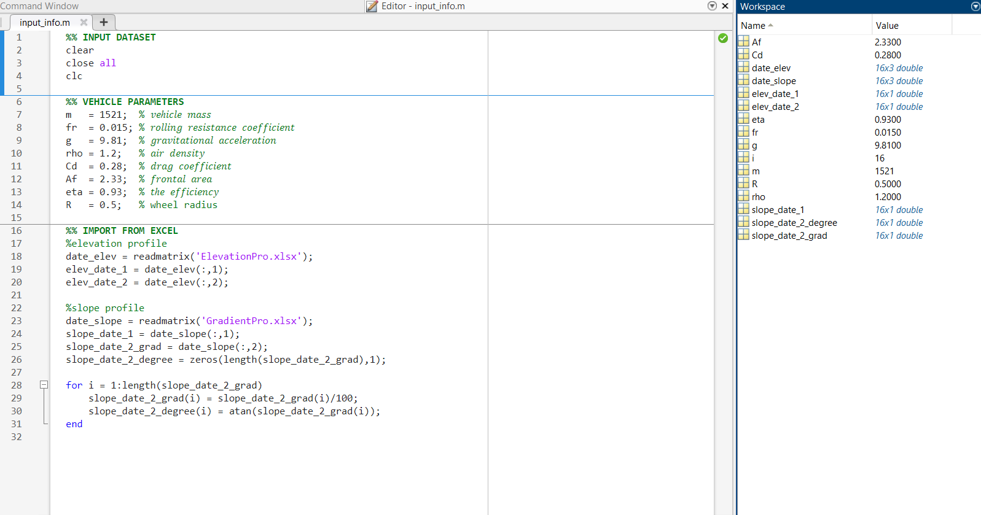
MATLAB CODE:-

Slide 8
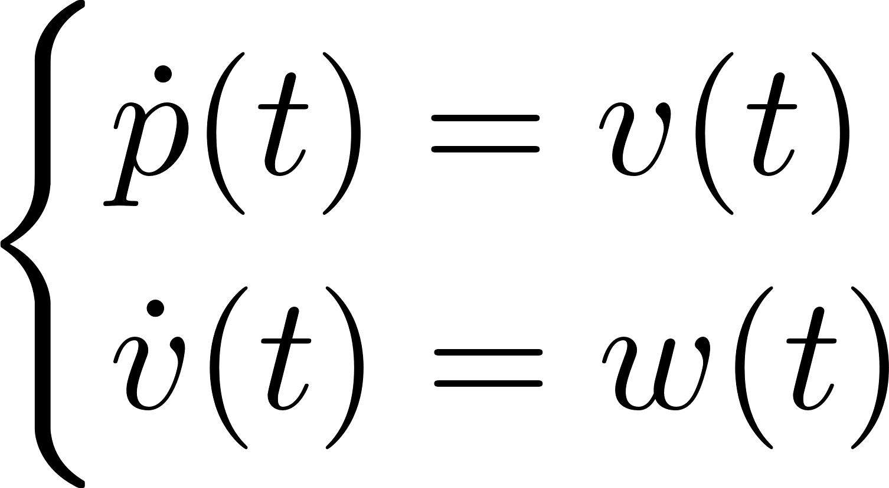
FEEDBACK LINEARIZATION (EGO VEHICLE):-
NON-LINEAR MODEL
CONTROL LAW
LINEARIZED MODEL

Slide 9
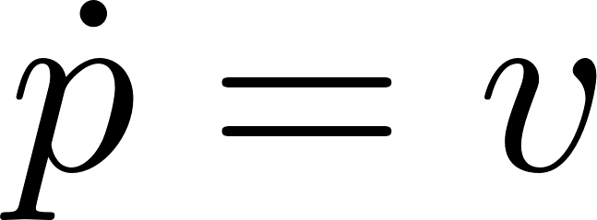
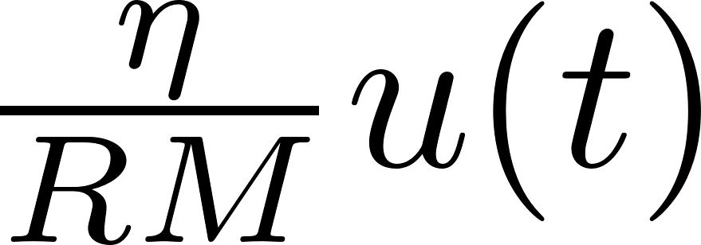
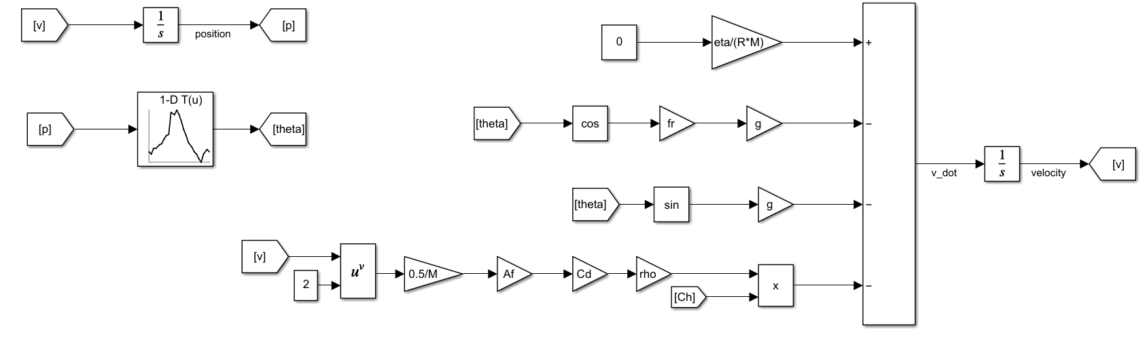
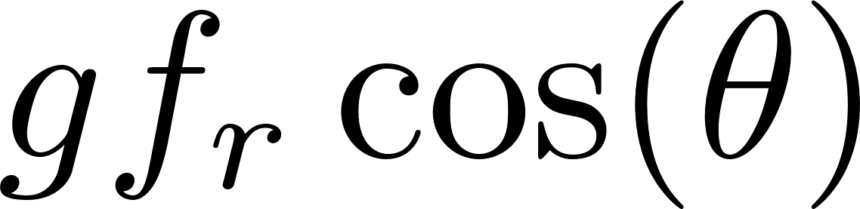
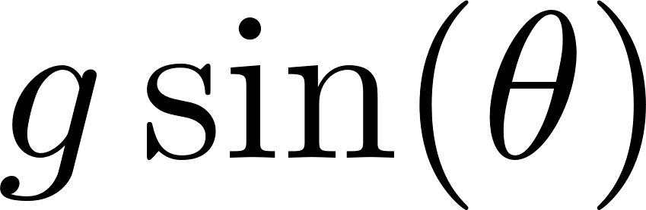
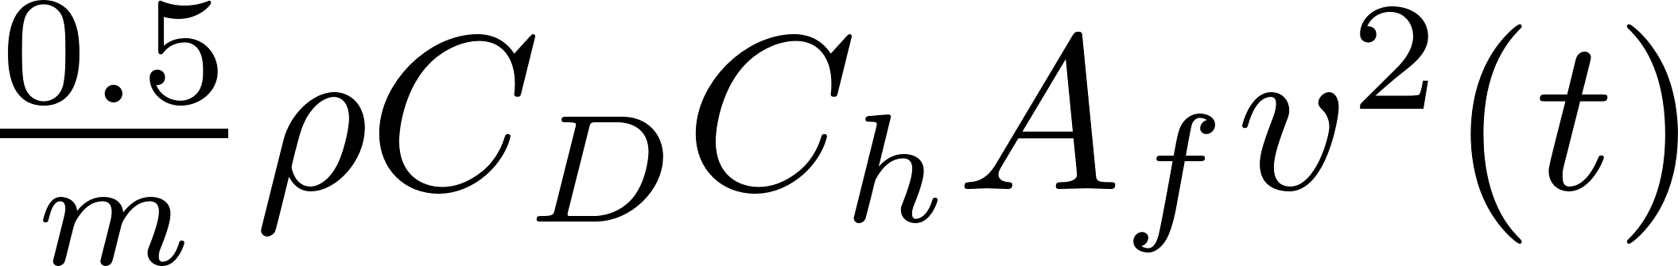
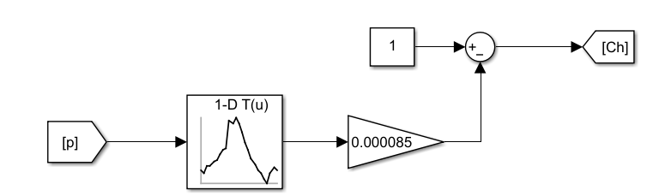

VEHICLE DYNAMICS (EGO CAR) SIMULINK MODEL:-

Slide 10
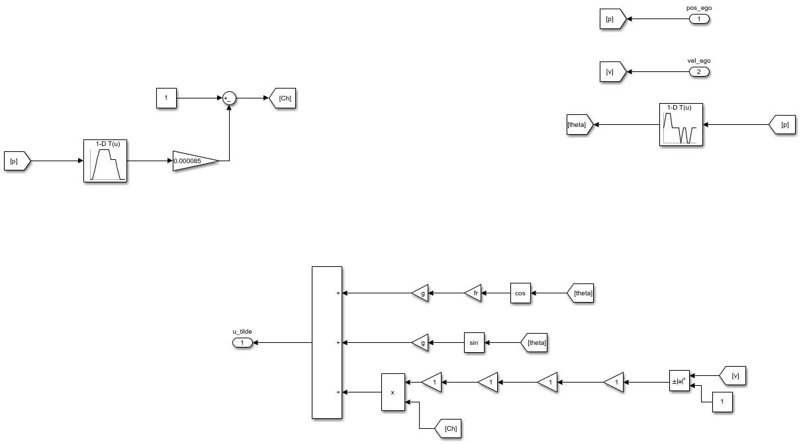
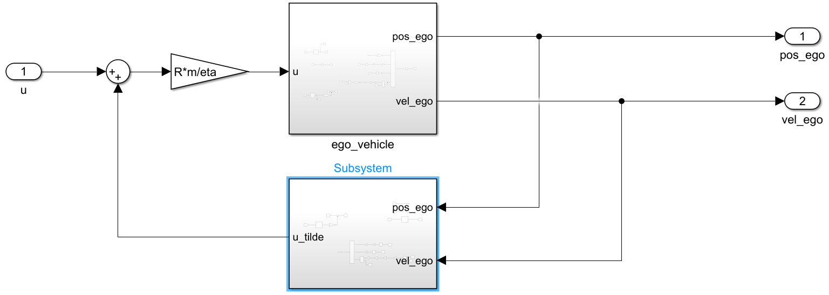
REVERSED VEHICLE DYNAMICS (EGO VEHICLE)
FINAL VELOCITY OF EGO VEHICLE
FINAL POSITION OF EGO VEHICLE
LINEARIZED MODEL (EGO VEHICLE)

Slide 11
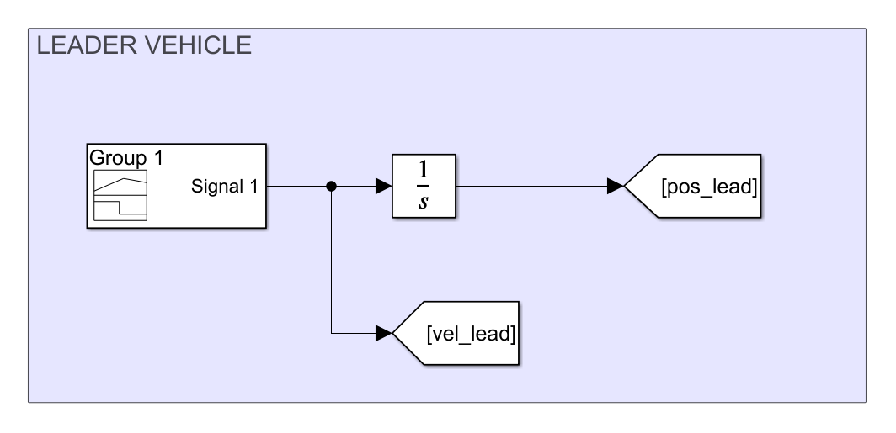
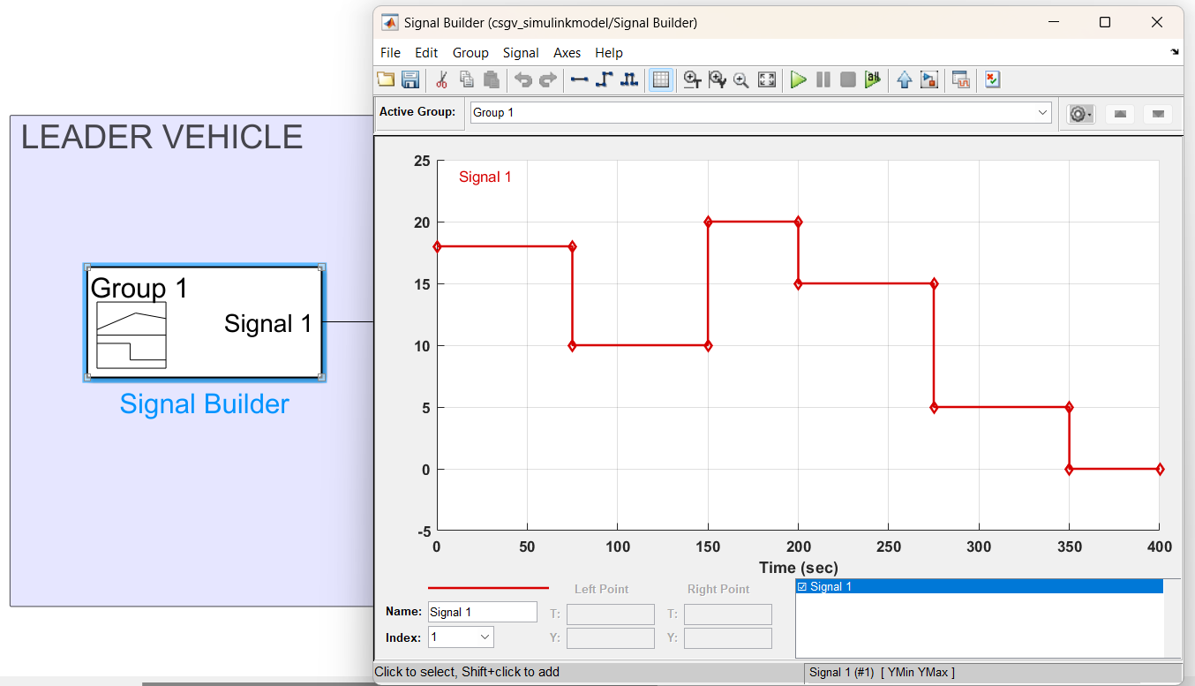
SIMULINK OF LEADING VEHICLE :-
Pulse waveform
as a
Velocity Input of Leader Vehicle.
Position is Directly
proportional to
Velocity & time.

Slide 12
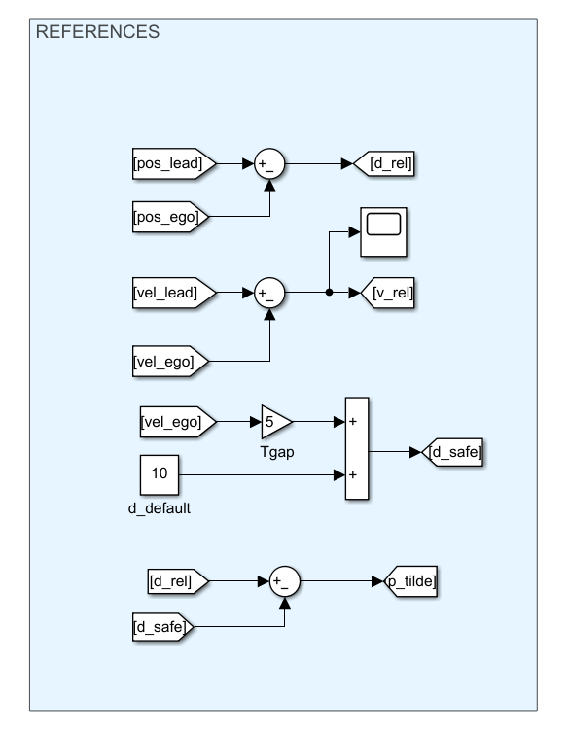
REFERENCS
OF
ACC:-

Slide 13
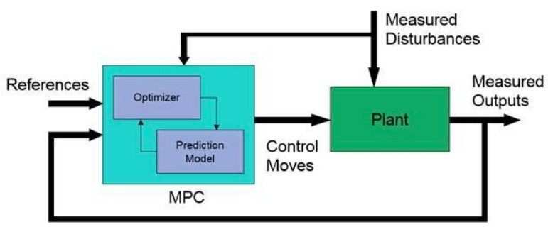
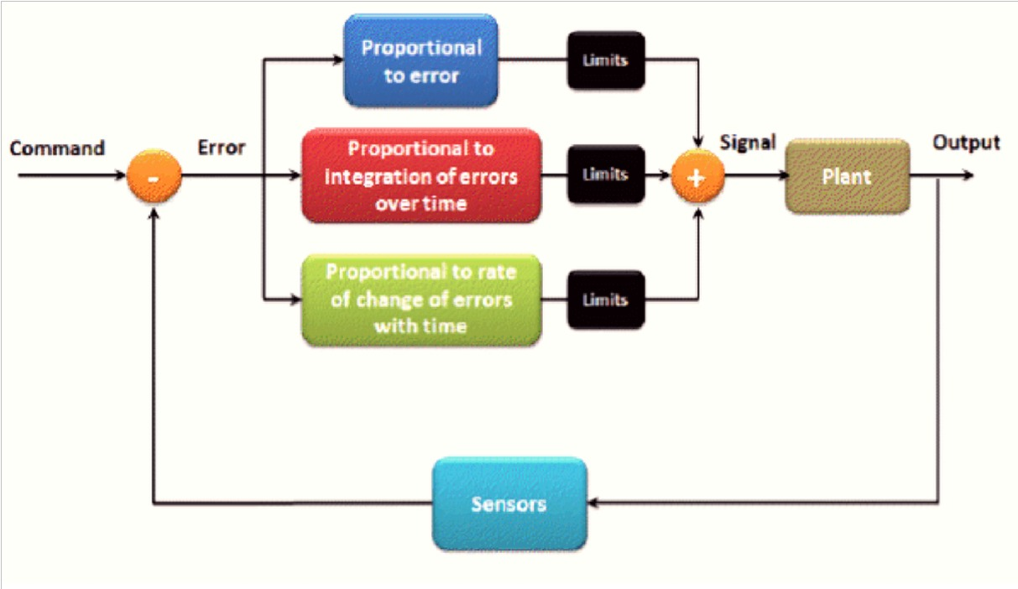
MPC Controller Vs PID Controller:-
The MPC controller uses algorithms in adjusting the control points with a consideration of various operation constraints and prediction of disturbances. Its further aids in energy storage systems, renewable energy sources, and energy efficiency enhancement.
On the other hand, the PID controller automatically adjusts the control output based on the input data. If the difference between current point and set point occurs, then the adjustment takes place.
Model Predictive Control (MPC)
PID controller

Slide 14
Model Predictive Control (MPC):
Model predictive control (MPC) is an optimal control technique in which the calculated control actions minimize a cost function for a constrained dynamical system over a finite, receding, horizon. At each time step, an MPC controller receives or estimates the current state of the plant.
Benefits of MPC Controller:
System model for expecting control actions.
Integration of a disturbance model for disturbance rejection.
Ability to handle constraints and uncertainties.
Ability to handle time-varying dynamics.
Integration of energy conservation strategies in the controller formulation.
Use of a cost function for achievement of multiple objectives.
Use of advanced optimization algorithms for computation of control vectors.
Ability to control the system at both the supervisory and local loop levels.

Slide 15
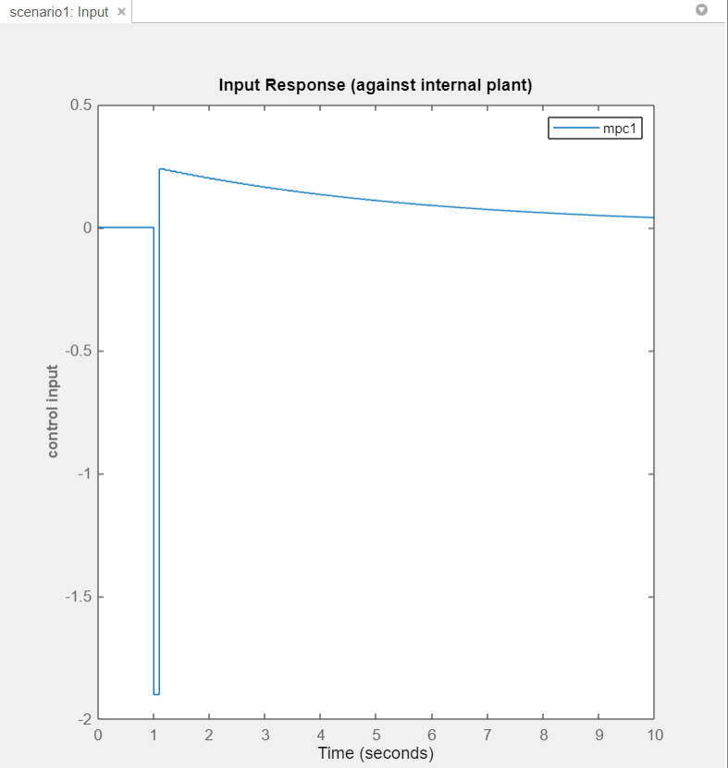
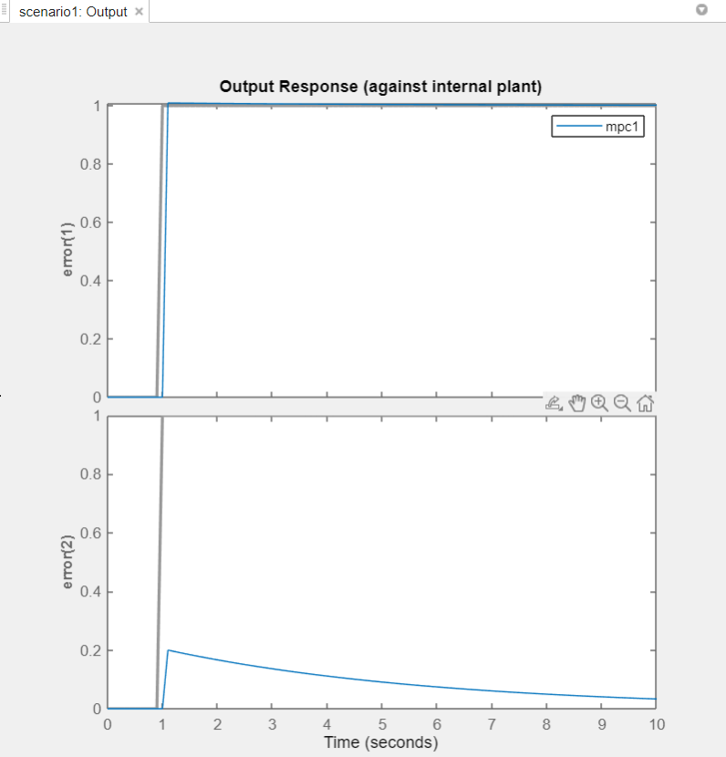
MPC DESIGNER

Slide 16
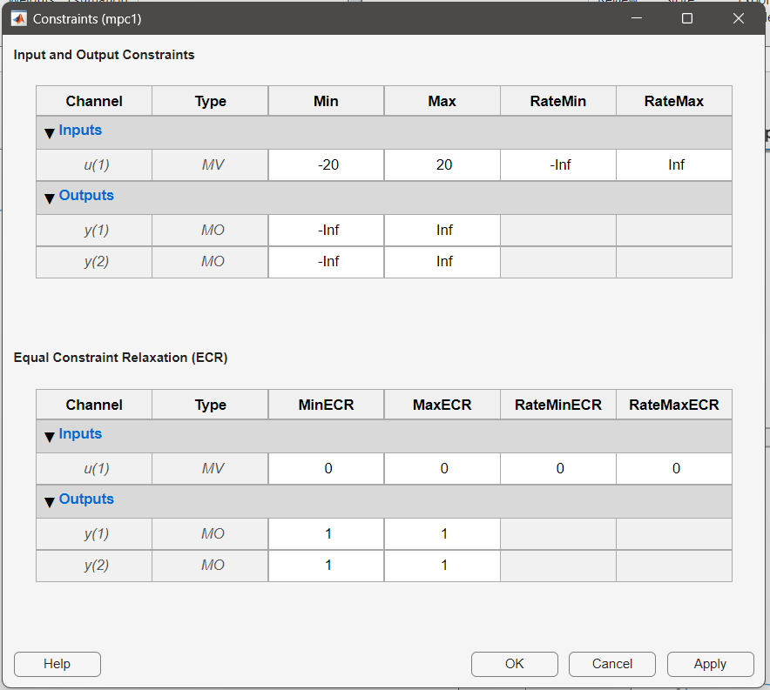
WHAT IS CONSTRAINS & WHY IT IS IMPORTANT IN MPC?
The constraints in an MPC (Model Predictive Control) controller refer to limitations imposed on the control inputs or system states. These constraints ensure that the control actions remain within certain bounds to avoid violating physical limitations or operating conditions.
Constraints are important in MPC (Model Predictive Control) controllers for several reasons:
Safety
Physical limitations
Actuator limitations
Stability
Performance optimization
Overall, constraints in an MPC controller are vital for
maintaining system safety, respecting physical limitations,
ensuring actuator feasibility, promoting stability,
and optimizing performance.

Slide 17
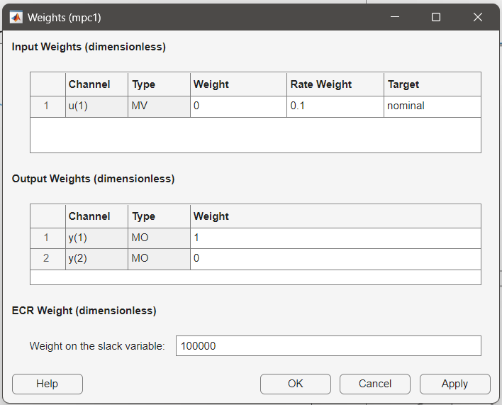
WHAT IS WEIGHTS & WHY IT IS IMPORTANT IN MPC?
In an MPC (Model Predictive Control) controller, weights refer to the relative importance assigned to different control objectives or costs. These weights are used to classify and balance the trade-offs between various control objectives during the optimization process.
The importance of weights in an MPC controller can be summarized as follows:
Objective classify
Performance optimization
Control trade-offs
Flexibility and adaptability
In summary, the weights in an MPC controller are essential
for classifying control objectives, optimizing system
performance, managing trade-offs between competing
objectives, and enabling adaptability to changing conditions.

Slide 18
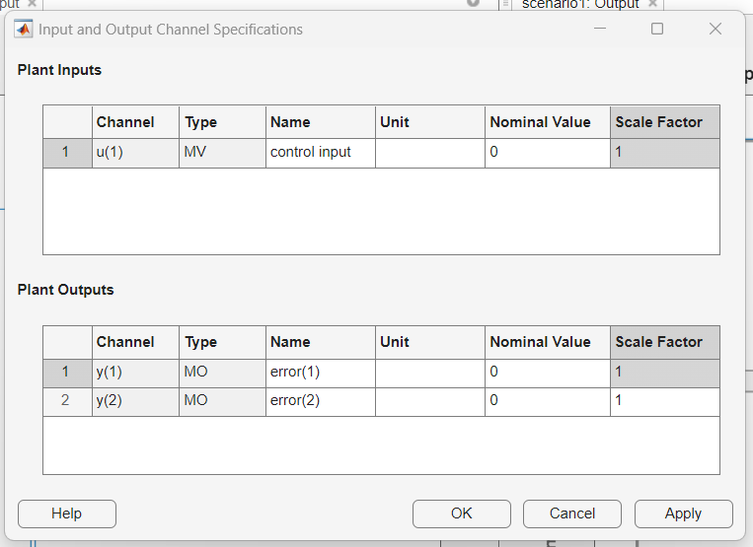
WHAT IS THE SCALE FACTOR IN MPC & WHY IT IS IMPORTANT ?
In an MPC (Model Predictive Control) controller, the scale factor refers to a parameter that scales the importance or sensitivity of the control objectives or constraints. It is used to adjust the relative influence of different objectives or constraints in the controller's optimization process.
The importance of the scale factor in an MPC controller can be summarized as follows:
Control objective balancing
Constraint management
Performance optimization
Adaptability
In summary, the scale factor in an MPC controller is important
for balancing control objectives, managing constraints,
optimizing performance and enhancing adaptability. It allows for
fine-tuning the relative importance of objectives and constraints,
leading to improved control performance and flexibility.

Slide 19
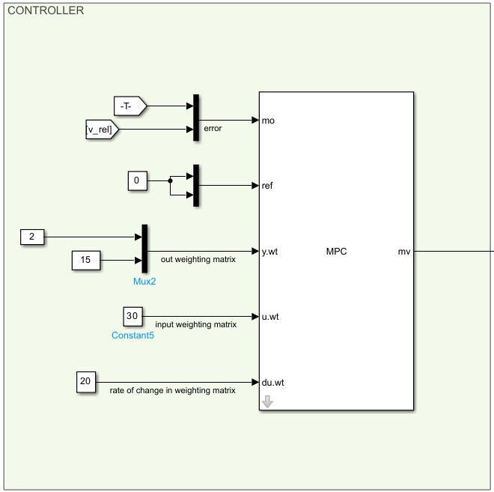
CONTROLLER

Slide 20
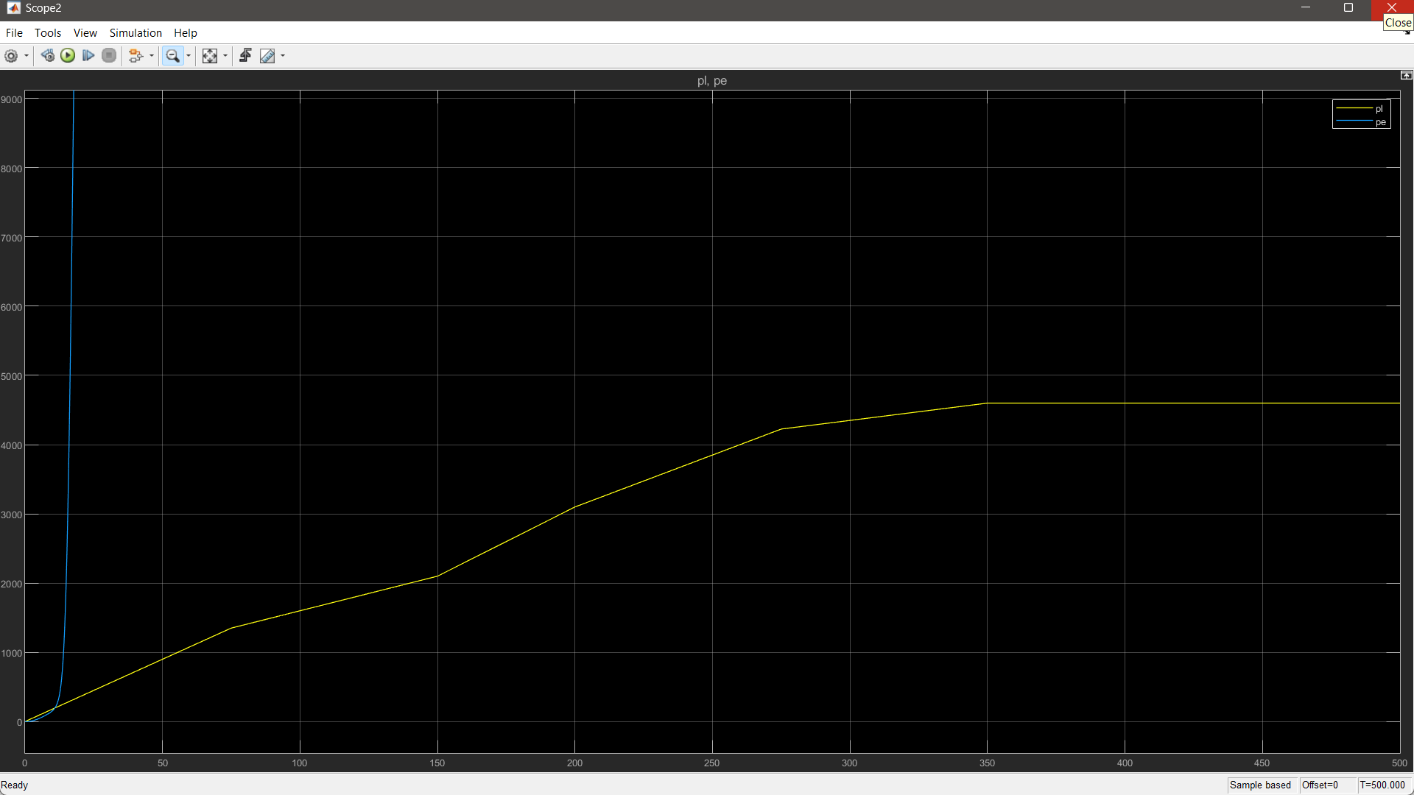
IF WE KEEP
SCALE FACTOR:1
WE GOT THIS POSITION GRAPH

Slide 21
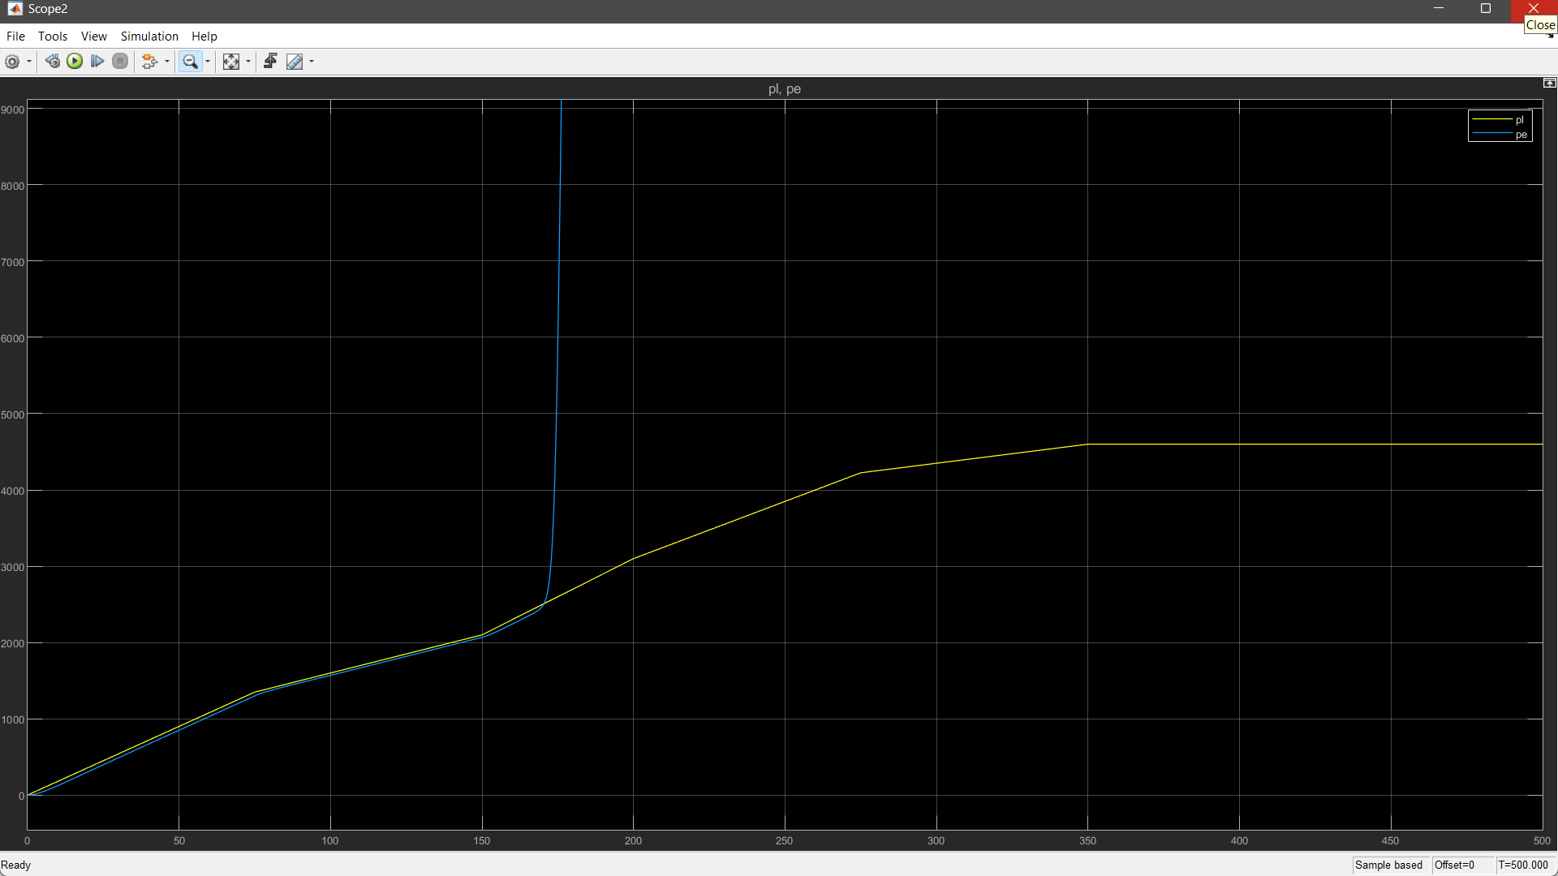
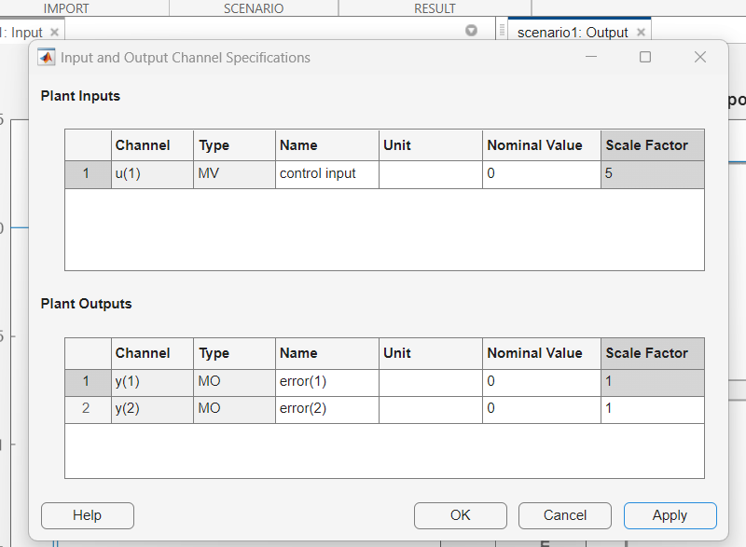
IF WE KEEP
SCALE FACTOR:5
WE GOT THIS POSITION GRAPH

Slide 22
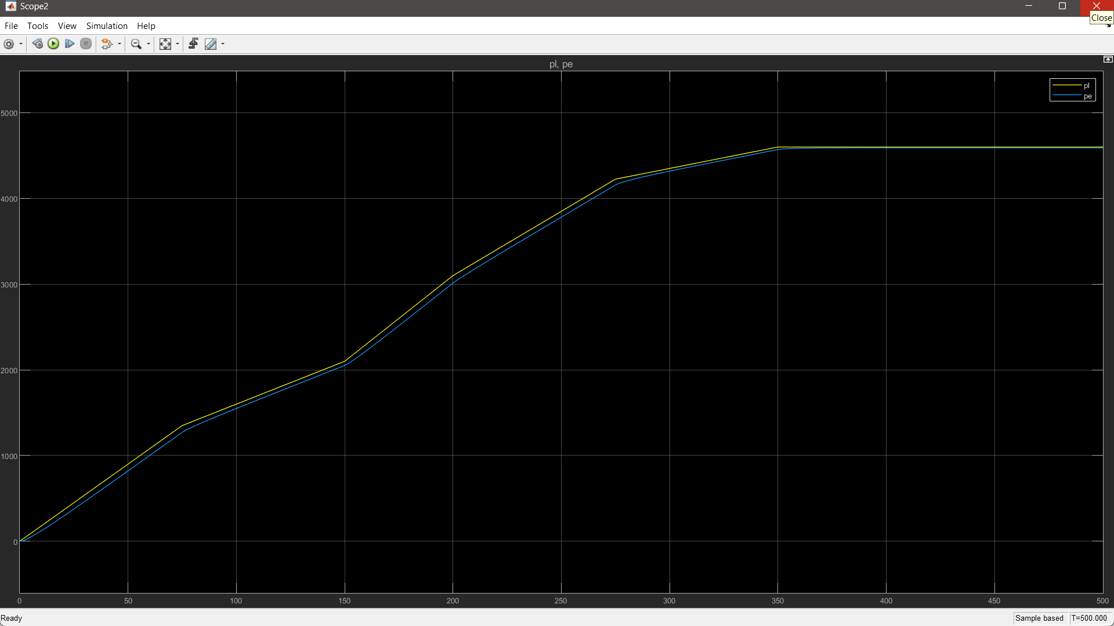
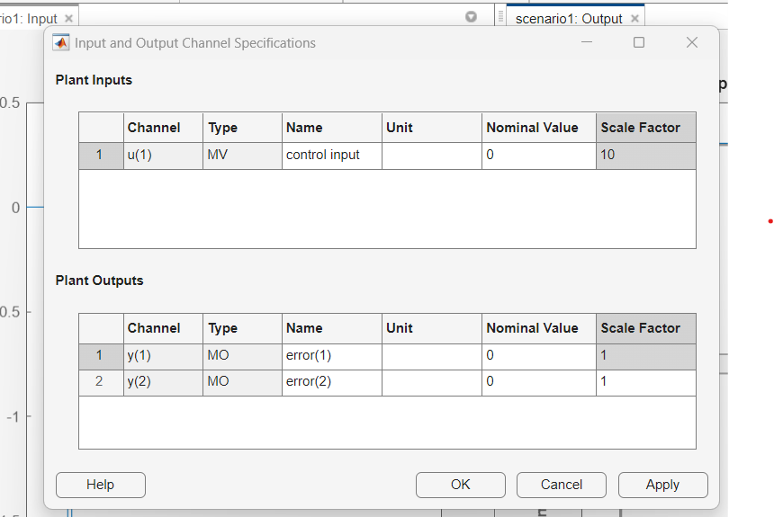
IF WE KEEP
SCALE FACTOR:10
WE GOT THIS POSITION GRAPH

Slide 23
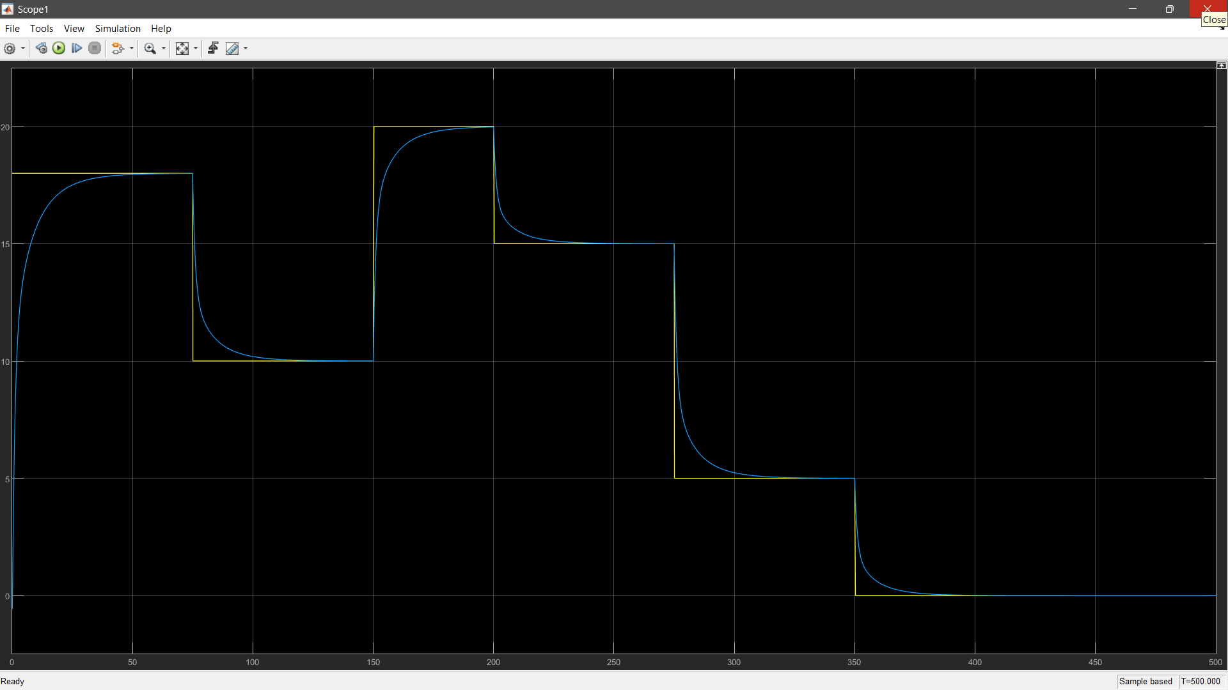
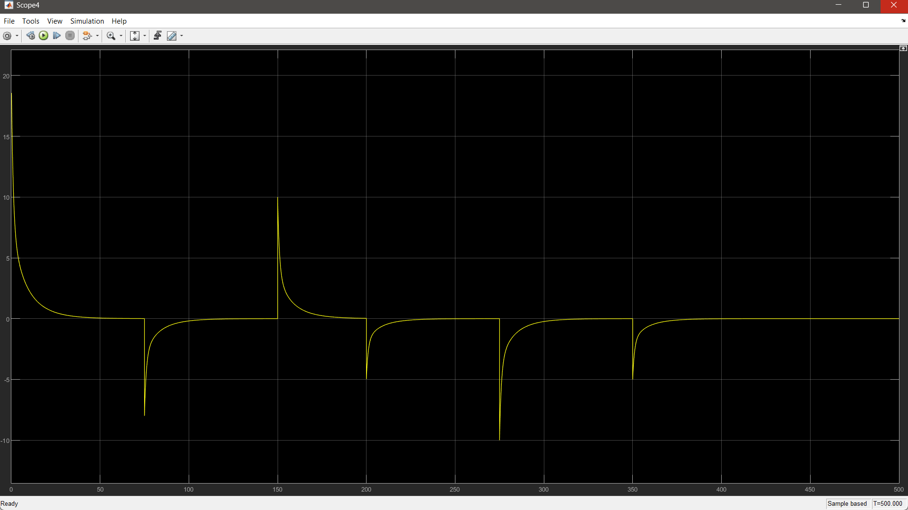
ACCELERATION
GRAPH
VELOCITY
GRAPH

Slide 24
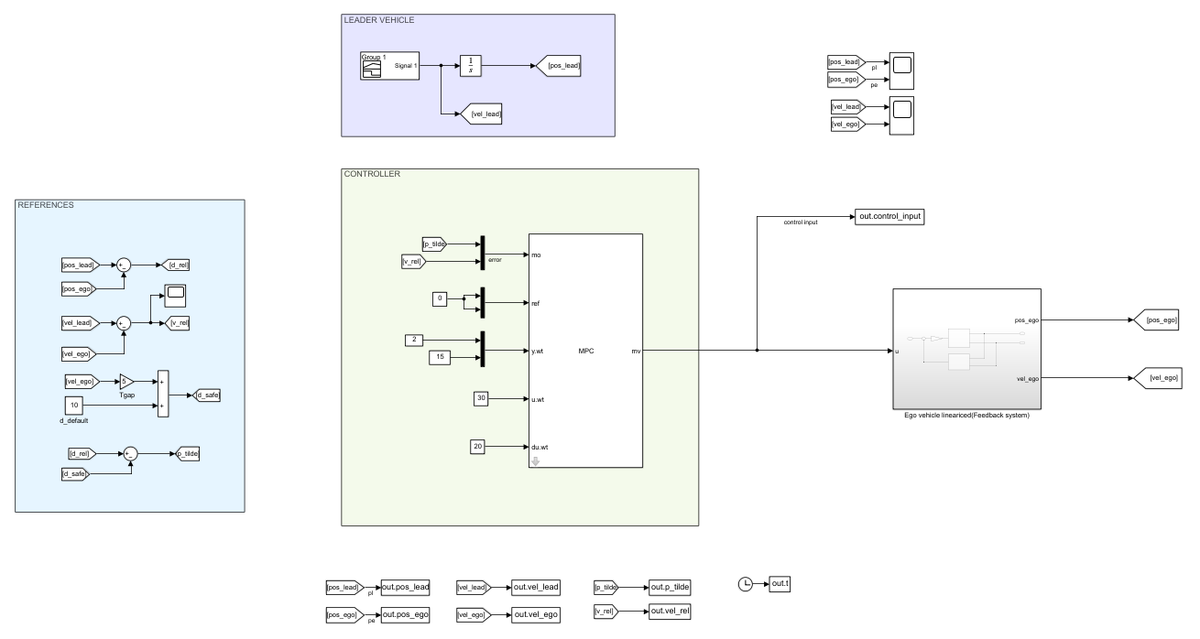
FINAL SIMULINK MODEL:-
INPUT OF
EGO VEHICLE
WORLD
CLOCK

Slide 25
CONCLUSION OF THE SYSTEM:
The combination of MPC and ACC in an Advanced Driver-Assistance Systems (ADAS) provides an absolute solution for autonomous vehicle control. MPC enhances the overall vehicle control by considering various dynamic aspects and optimizing control actions in real-time. ACC adds an additional layer of safety by intelligently adjusting the vehicle's speed to maintain safe distances, reducing the risk of accident.
By utilizing these advanced methods:
the Advanced Driver-Assistance Systems (ADAS) can Improve the autonomous vehicle's performance.
Improve passenger safety and reduce the accidents.
Overall, the integration of MPC and ACC technologies offers an efficient approach for designing an Advanced Driver-Assistance Systems (ADAS) that can contribute to the success of autonomous vehicles in the future.
Notes:
25

